Slide 1
Business Process Intelligence Challenge (BPIC) 2013 Open Problems
Presented by Group 3:
Group members
Md Ziauddin Ridoy - 220100676
Sudheer Kumar Ala – 220200904
Nishikanth Palaka - 220200940
Aneesa Sultana Jagaraspalli - 220201586

Slide 2
INTRODUCTION
BPIC 2013 ,created by Ward Steeman, consists of Volvo IT Belgium’s log with events from an incident and problem management system called VINST.
In that log, there are both open and closed problems.
We are given the open problems dataset.
Its main aim is to provide a customer with his/her normal service operation as fast as possible when an issue arises.
Preprocessing is done using python, and the data analysis is done using the process mining tools Disco and PROM.

Slide 3
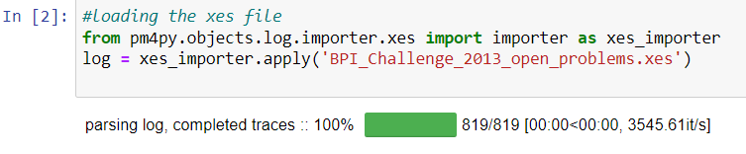
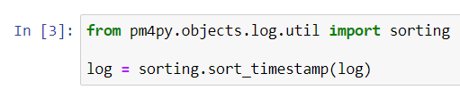
Data Pre-processing
Import through pm4py
Sorting through timestamp

Slide 4
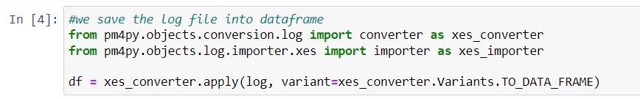
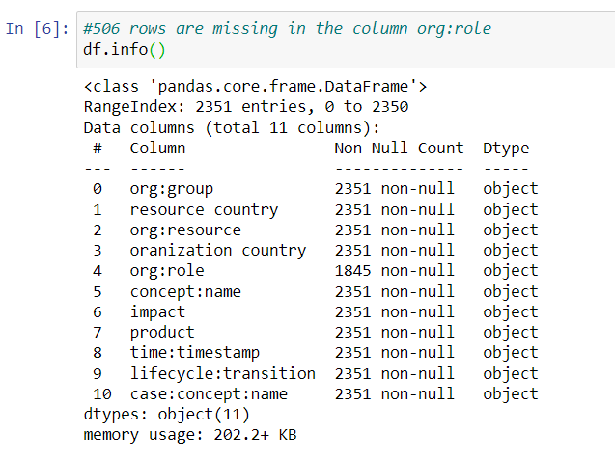
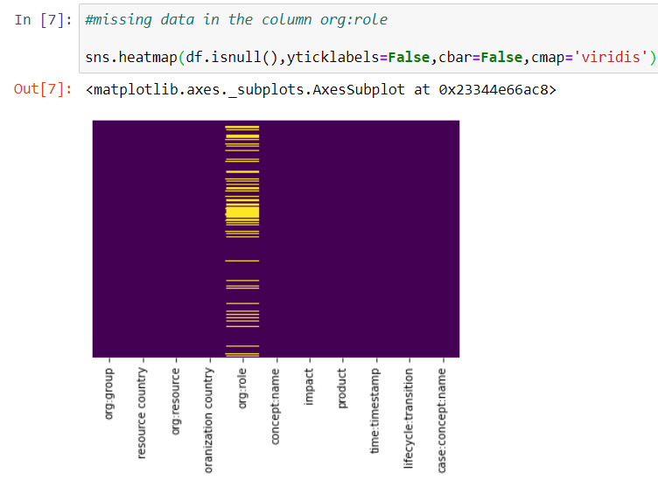
XES log file to pandas dataframe
Visualizing the missing data in the dataframe

Slide 5
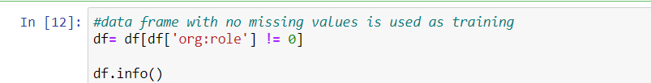
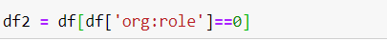
Linear regression for missing data
Training set
Test set

Slide 6
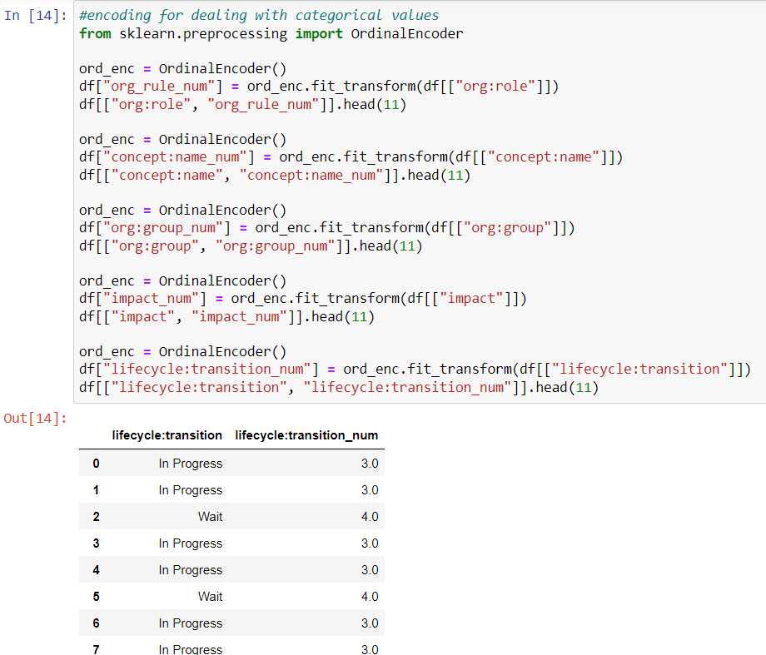
Encoding on the categorical data

Slide 7
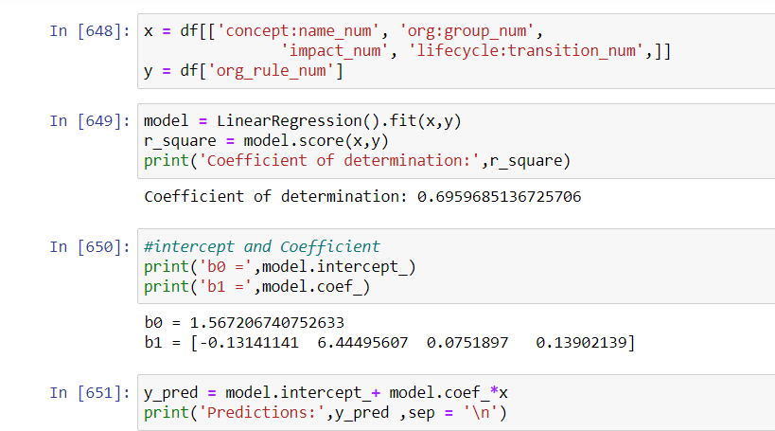
Regression
Implementing this process on both training and test.

Slide 8
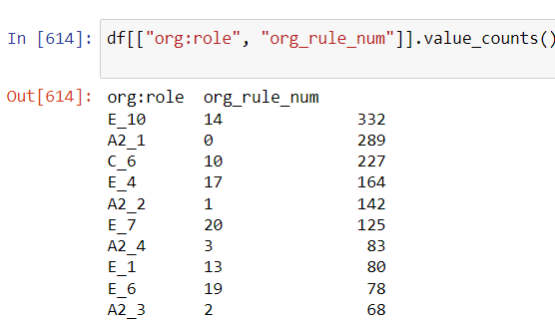
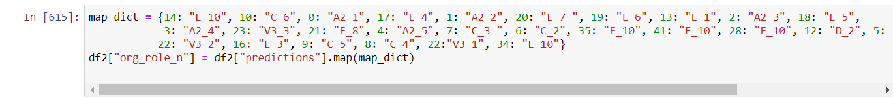
Re-assigning values based on predictions
Replacing the missing values in test set.

Slide 9
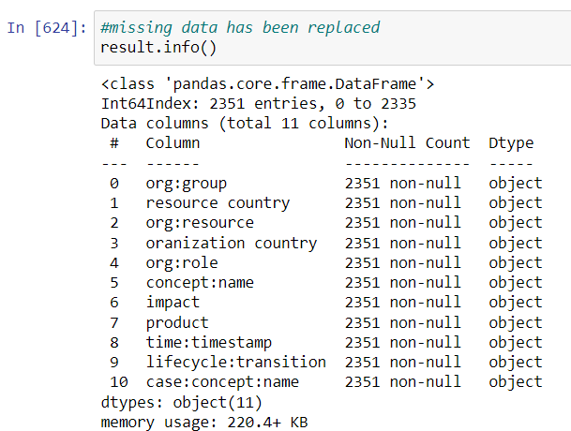
Missing data replaced

Slide 10
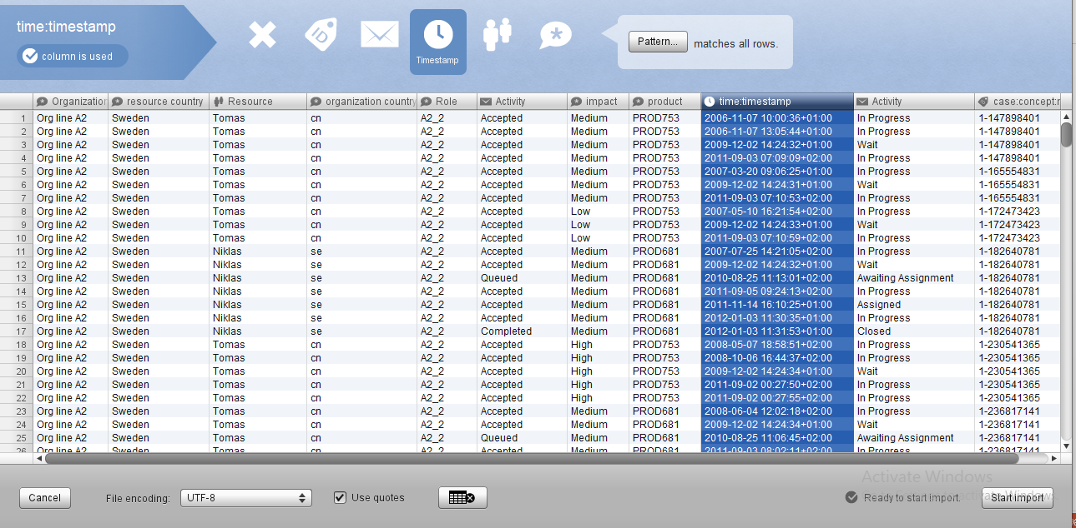
Analysing the pre-processed dataset using DISCO

Slide 11
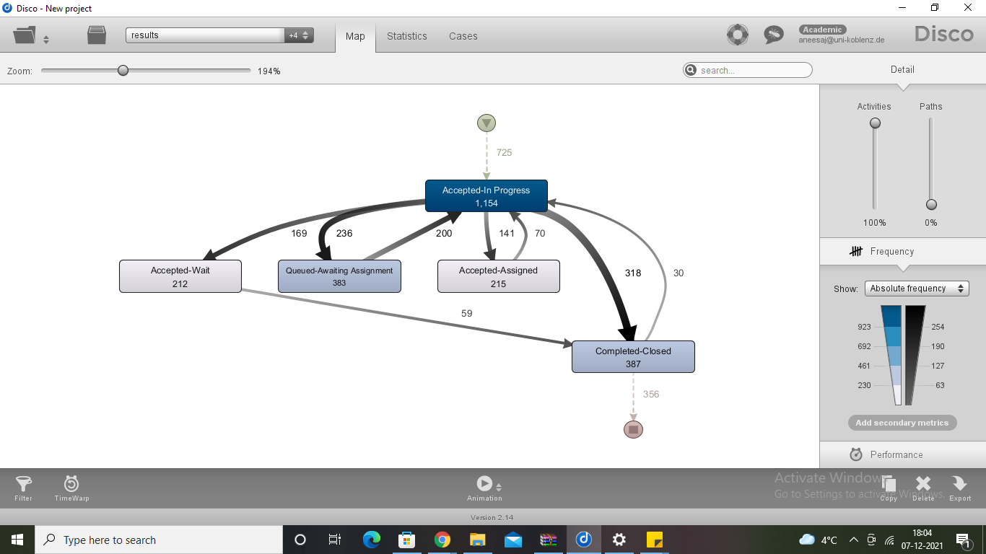
Process Map

Slide 12
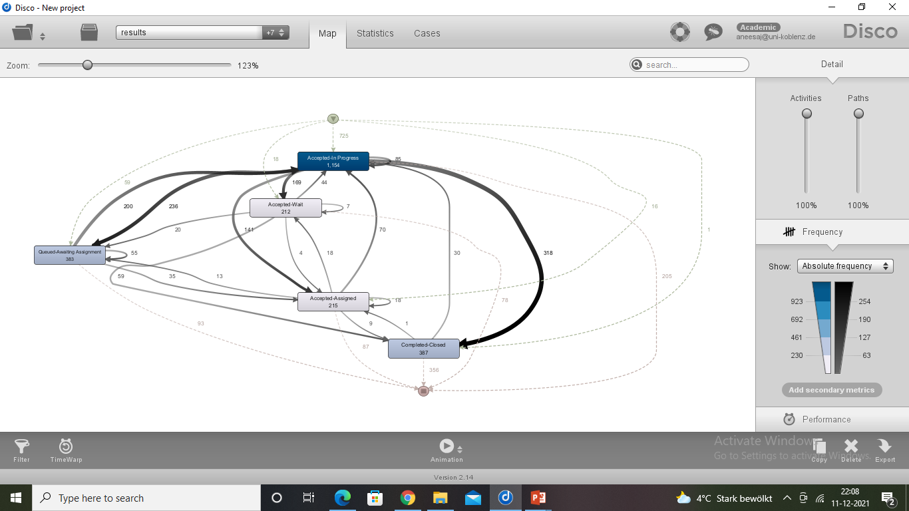

Slide 13
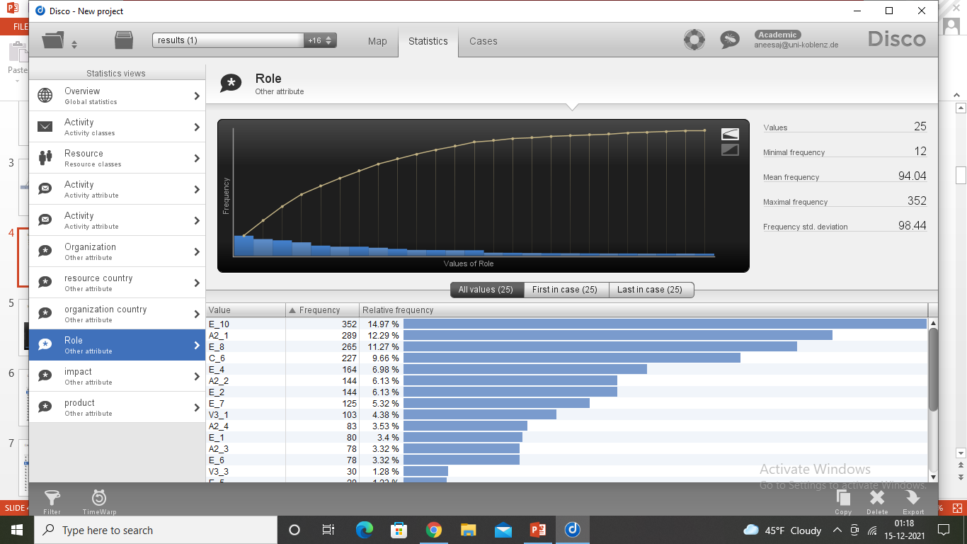
What are the roles of the people involved in various stages of the process?
There are a total of 25 roles.
Among all the different roles, E_10 has the highest contribution of 14.97%

Slide 14
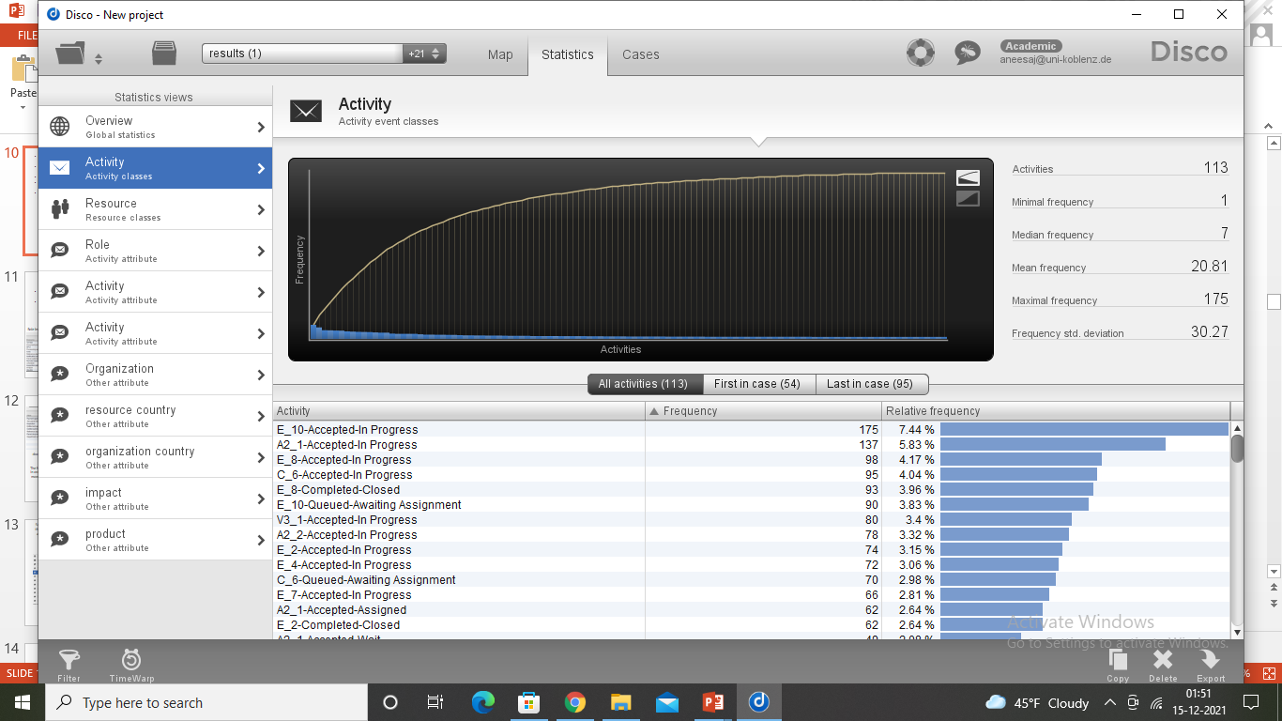
Major part of the work in the activity “in progress” is done by E_10 , A2_1, E_8 and C_6. E_8 and E_2 are working majorly on “completed-closed” activity.

Slide 15
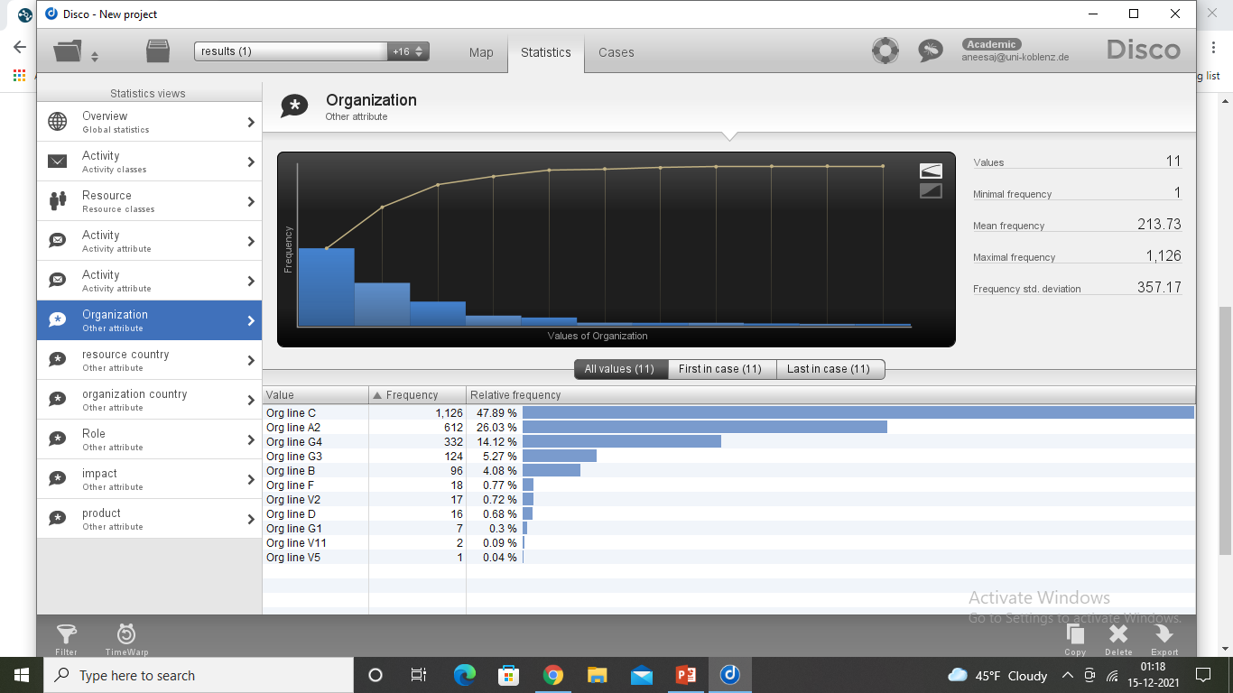
What are the possible points for improvement on the organizational structure?
Organization C has undoubtedly the highest frequency among the 11 organizations followed by organization A2.
Organization V11 and V5 have the least frequency.

Slide 16
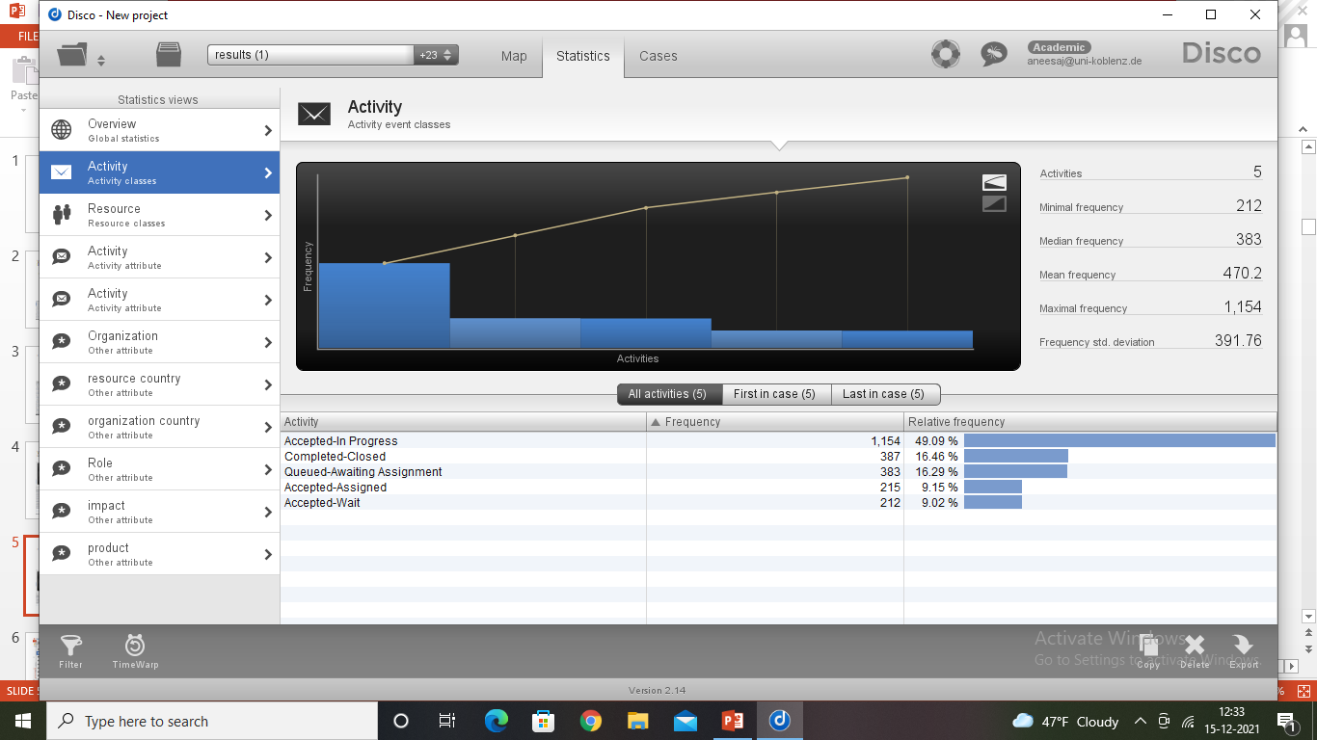
Among the 5 activities, “Accepted-in progress” has the major frequency followed by completed-closed and queued-awaiting assignment.

Slide 17
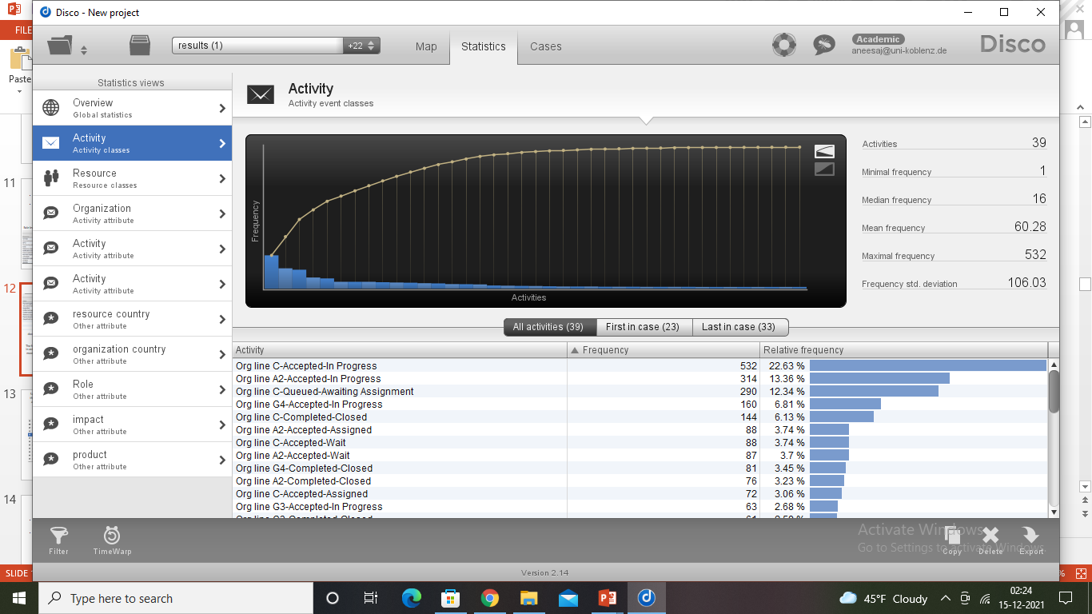
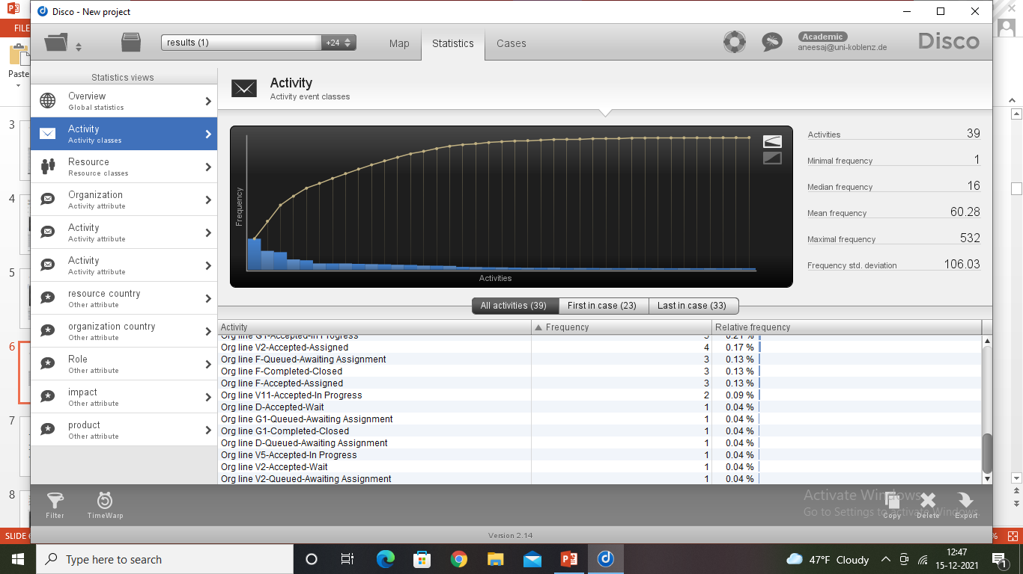
Organization C does performs different activities, but is more concerned about “Accepted-in progress” (22.63% frequency).
7 organizations contribute only 0.04% of frequency.
Hence if this gap of major and minor frequencies can be balanced among the organizations, there can be betterment.

Slide 18
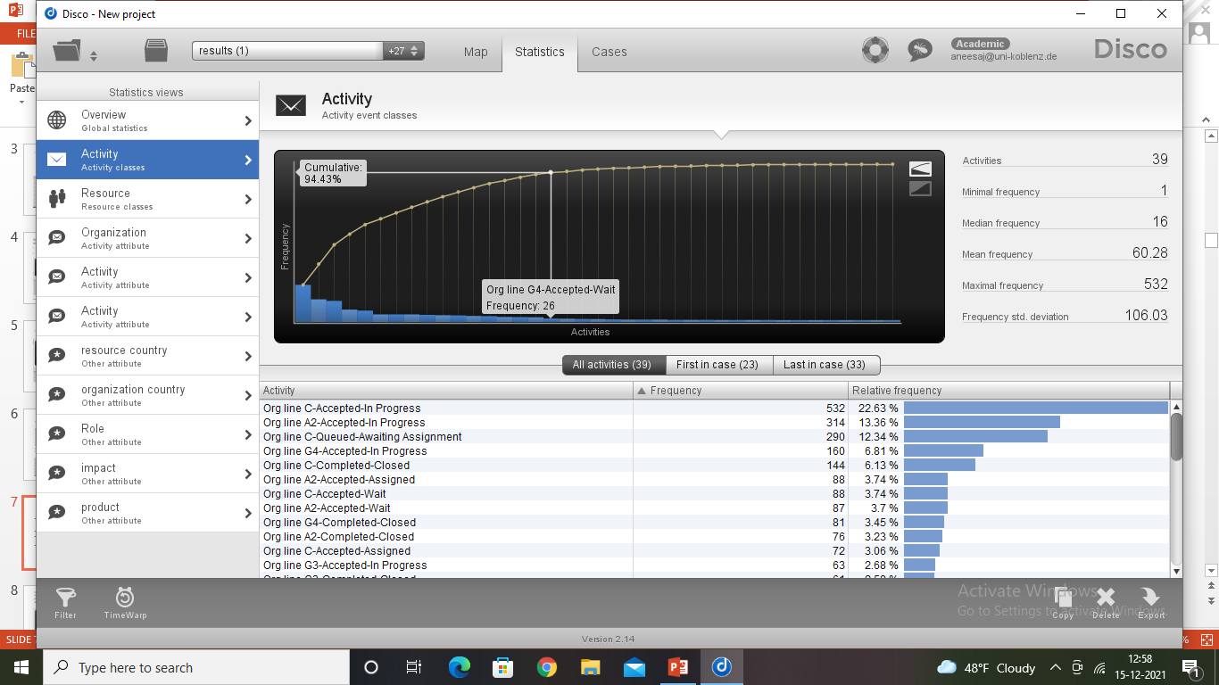
Organization line C is involved in many activities like accepted-in progress, queued-awaiting assignment, completed-closed, accepted-wait and so on.
Not just line C but all the organizations are involved in different activities.
Hence we can conclude that one organizational line is not confined to one activity but it is an all-in-all structure.
If this is changed and one organizational line can be assigned to particular processes, there can be improvement in the organizational structure.

Slide 19
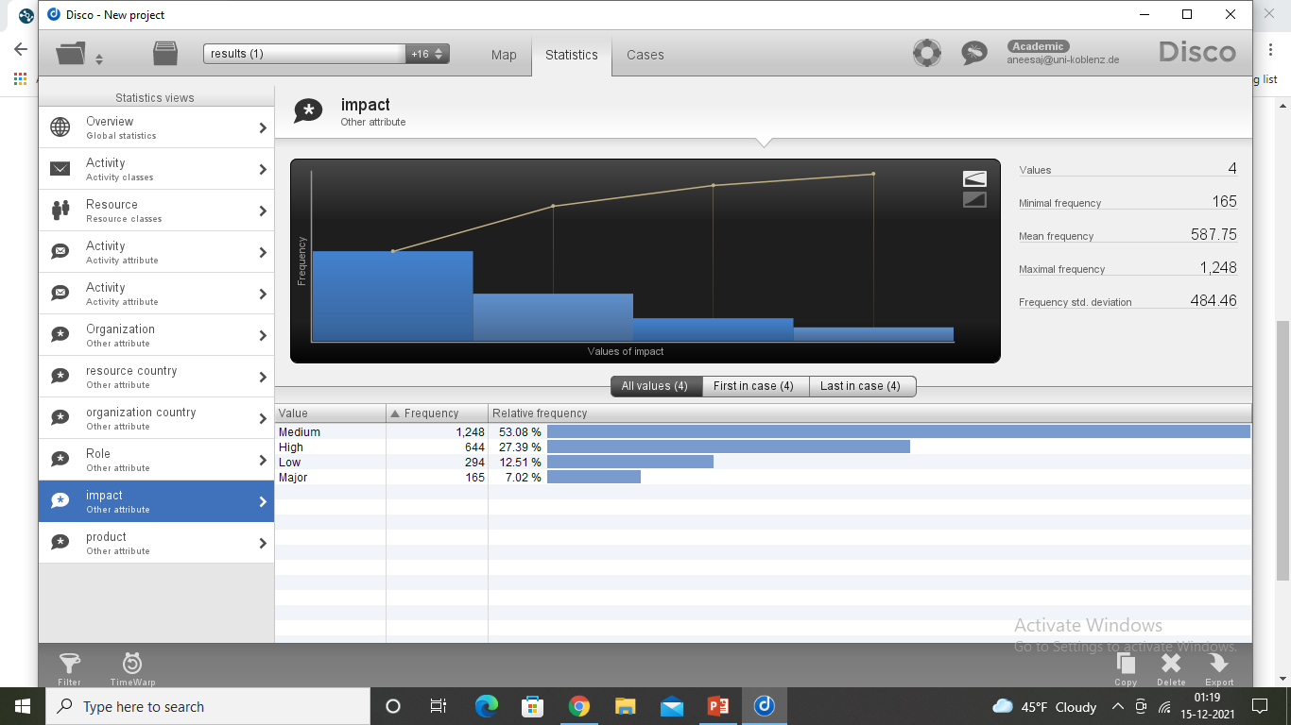
Some of the procedures will be outsourced in the year after the log ends, i.e. they will be removed from the process and the applicant needs to have these activities performed by an external party before submitting the application. What will be the effect of this on the organizational structures?
There are cases and processes with different impacts like major, high, medium and low.
Hence if outsourcing is done, the processes with low impact should be outsourced not the processes with high or major impact to reduce risk.

Slide 20
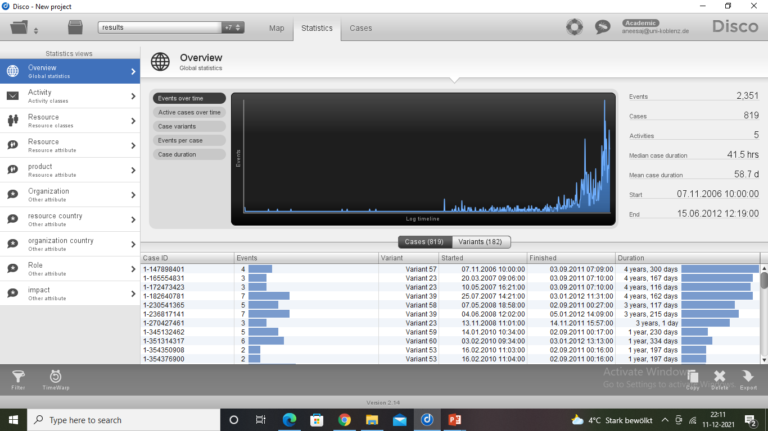
When looking at the throughput times, what comes to your attention?
For 819 cases, 2351 events were recorded.
Average case duration is 58.7 days i.e., it takes an average duration of 58.7 days for a case to be completely be processed and closed.

Slide 21
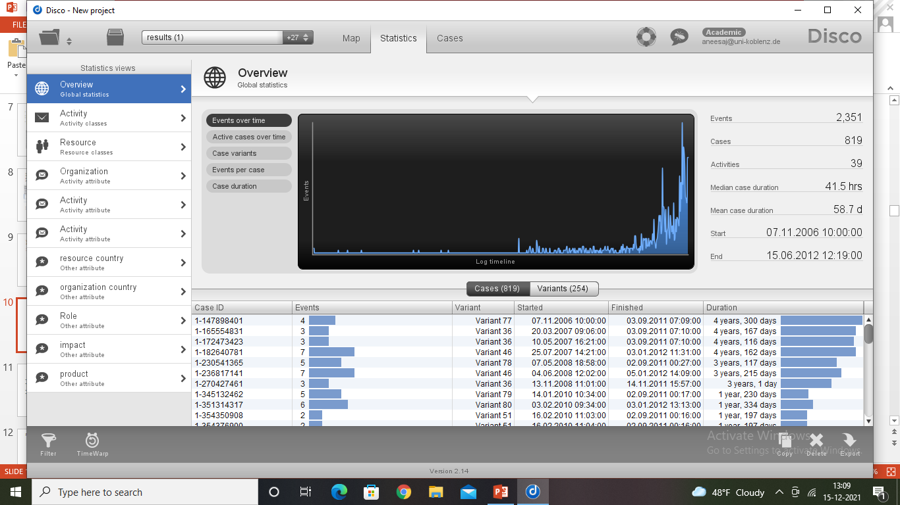
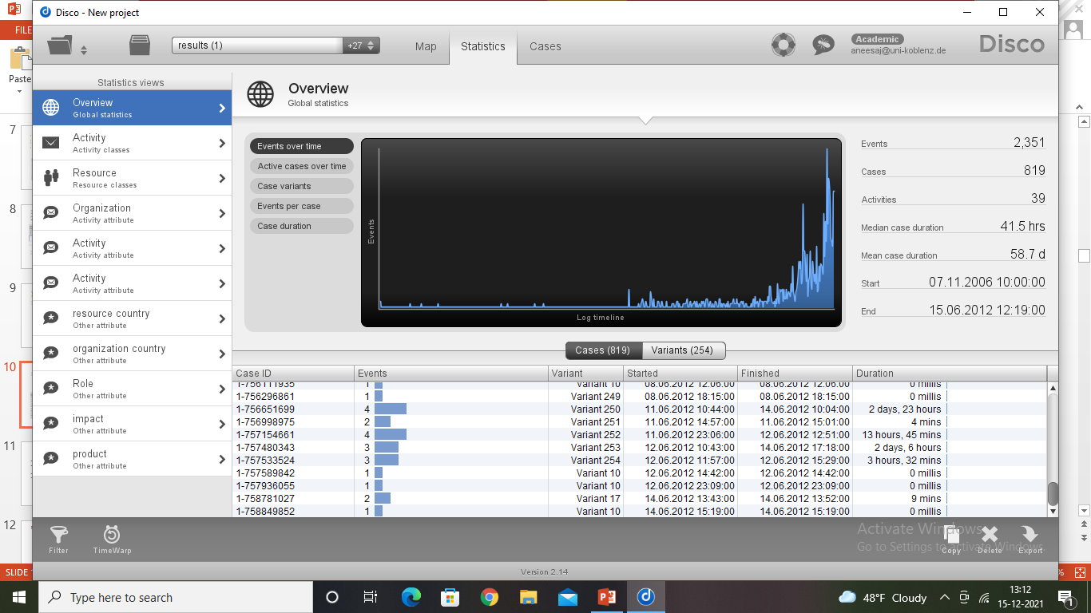
The throughput of a case is recorded as 4 years and 300 days which is quite very long.
While some cases took like literally no time and were finished instantly.

Slide 22
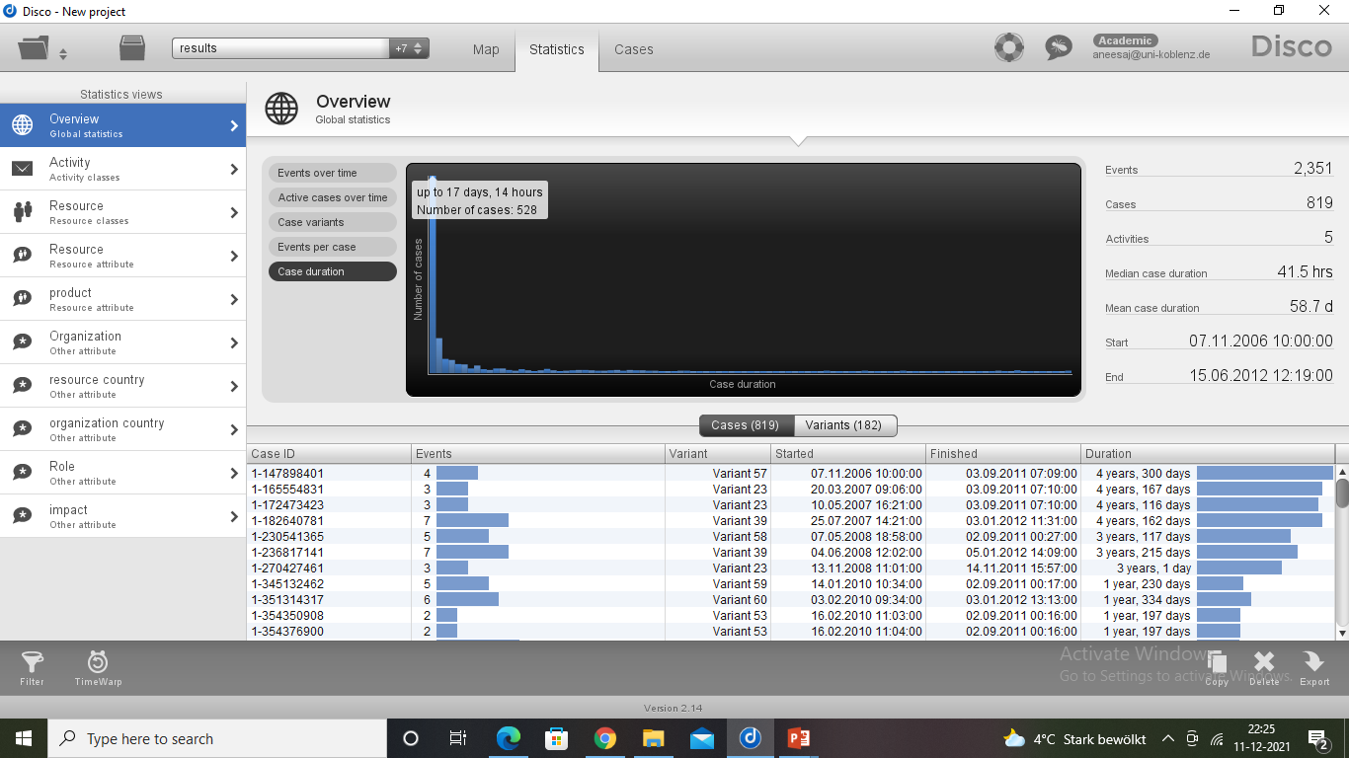
But 528 cases had a throughput of up to 17days and 14 hours.
This shows that around 65% of the cases have a throughput really less than the average throughput.

Slide 23
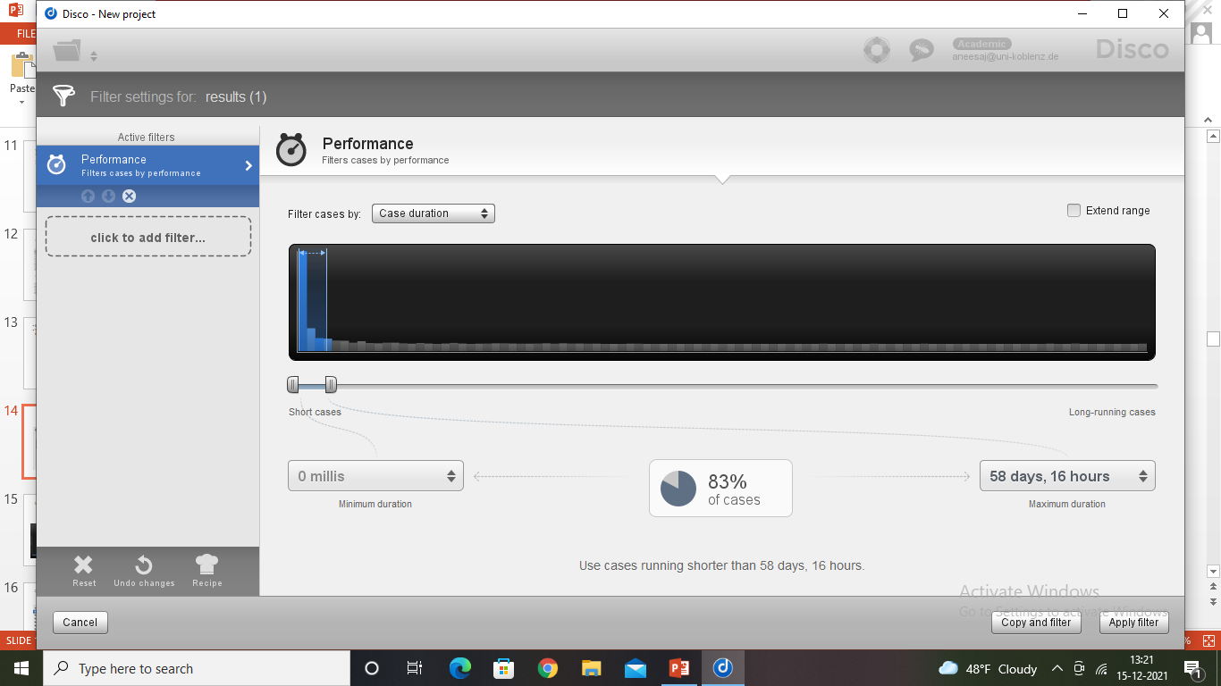
By applying the performance filter and setting the throughput of the cases from 0 to 58.7 days, we can see that 83% of the cases fall under the average throughput of 58.7 days.
Due to few cases that run too long, the average throughput got affected.

Slide 24
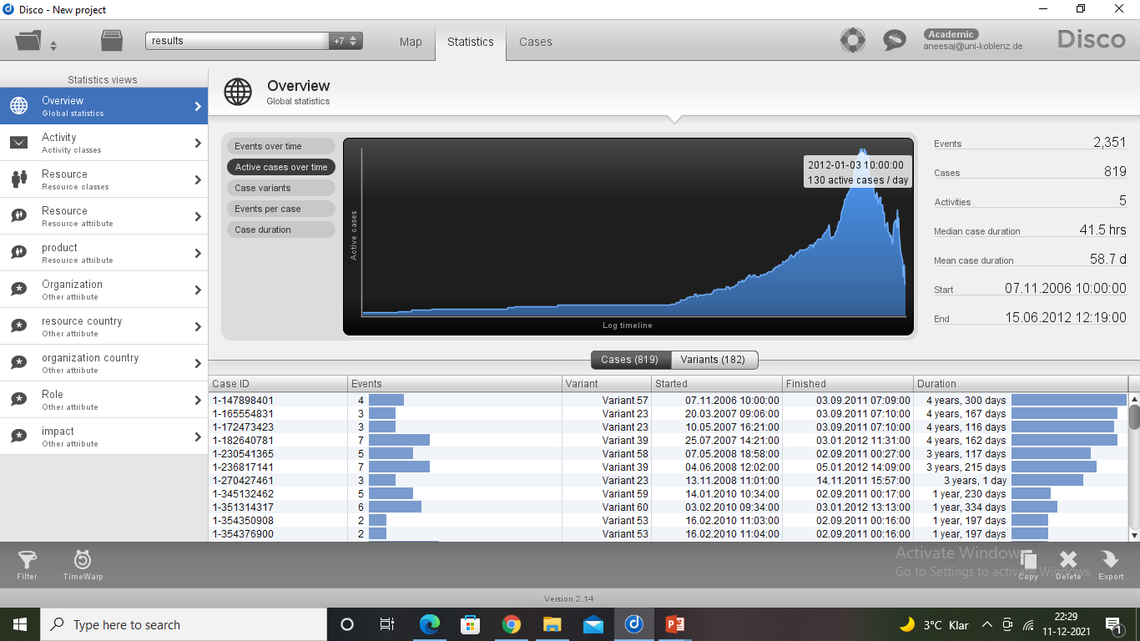
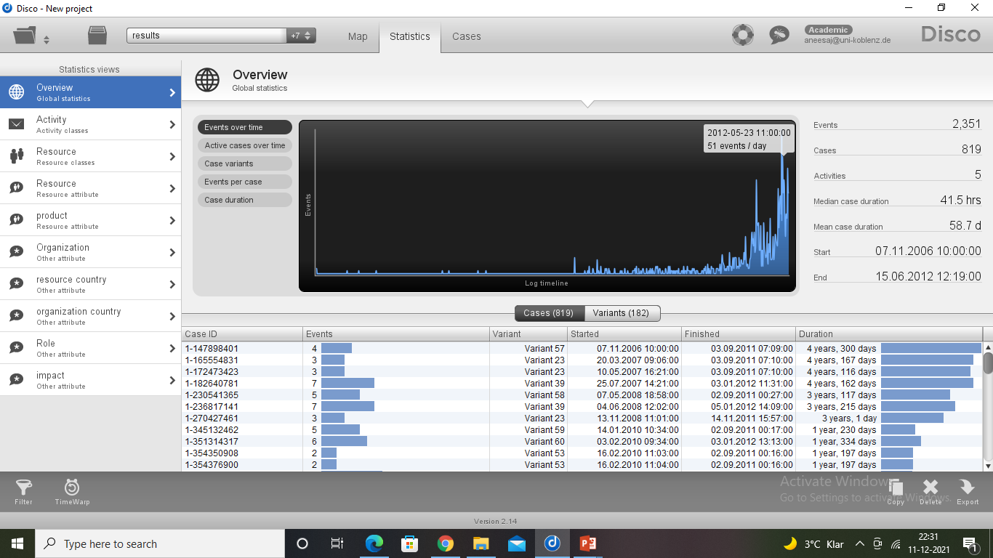
Other interesting statistics
On 3rd of January, 2012 a total of 130 active cases were recorded which is the highest for a day in the log.
On 23rd May, 2012 a total of 51 events were performed which is the highest for a day in the log.

Slide 25
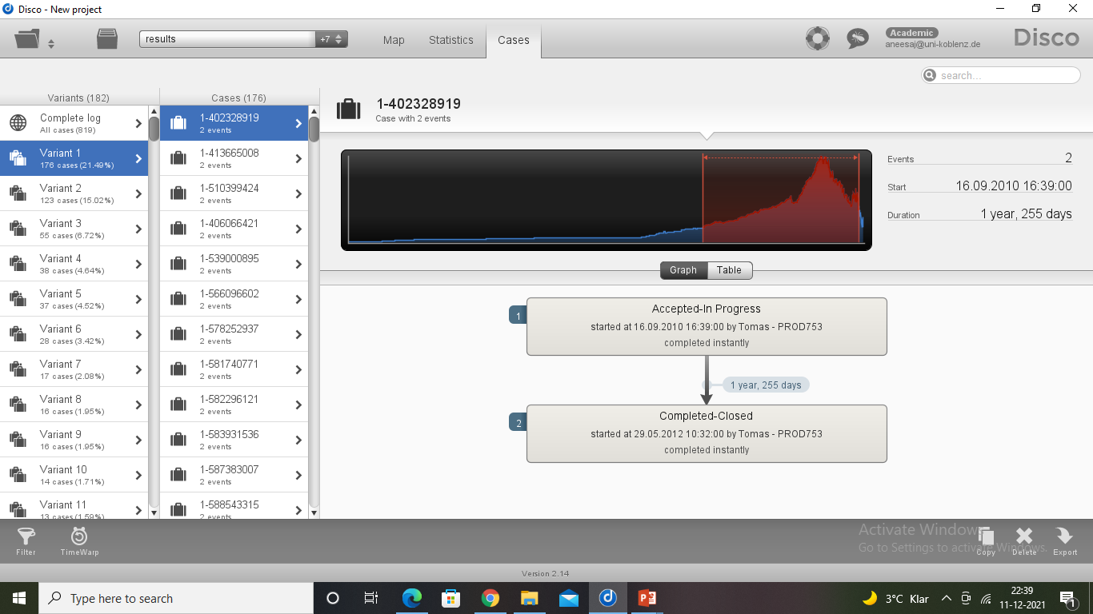
Every case is processed in a different way. 21.40% of the cases are processed in variant 1 which consists of only two activities: Accepted-In Progress and Completed-Closed.

Slide 26
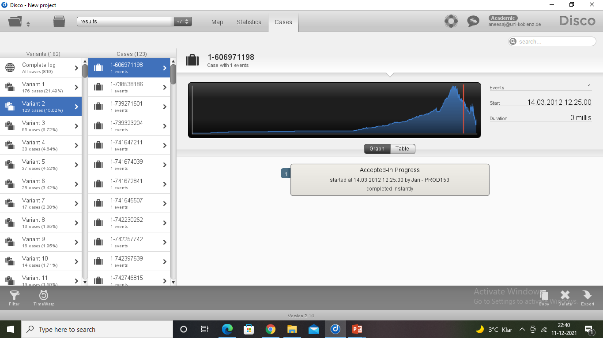
15.02% of the cases follow variant 2, which has only one activity: Accepted-In Progress. The processes which are completed instantly come under this variant.
We can say that a particular pattern is not followed to process a case, there are like 182 variants.
Hence this part can be improved.

Slide 27
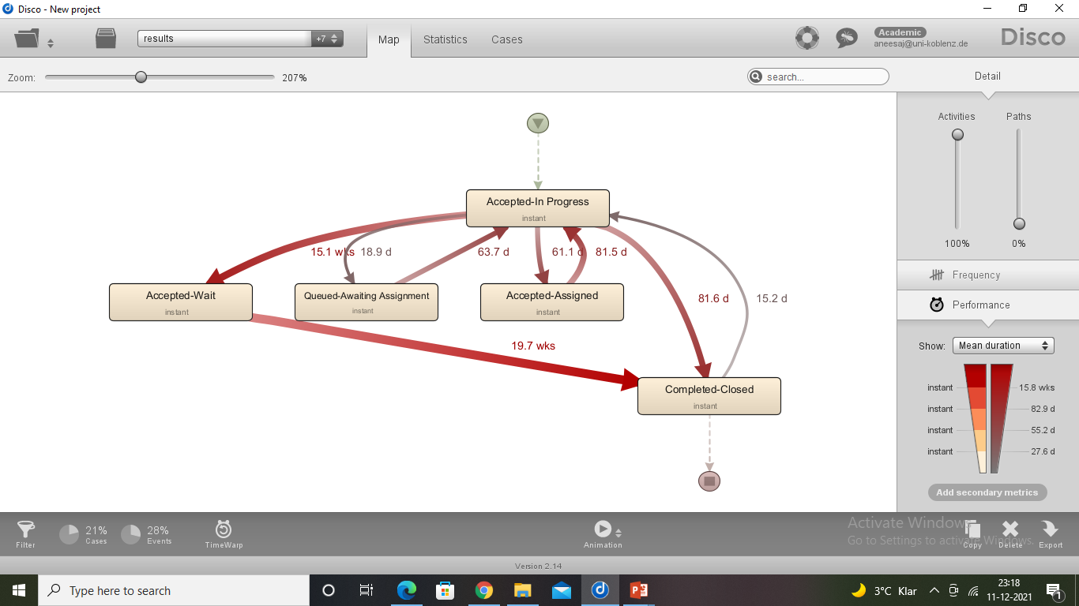
Performance Map – Mean duration

Slide 28
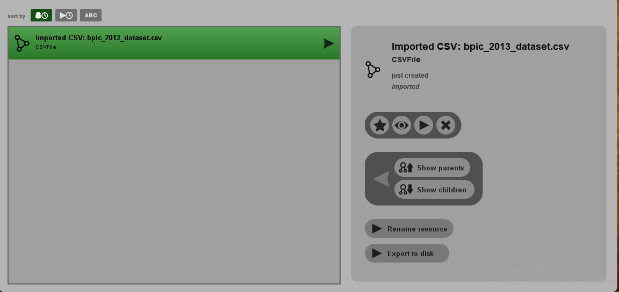
Analysing the pre-processed data using PROM
Importing dataset in Prom

Slide 29
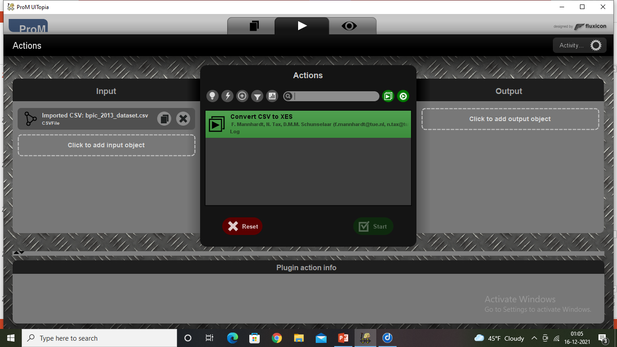
Converting CSV to XES to process the data

Slide 30
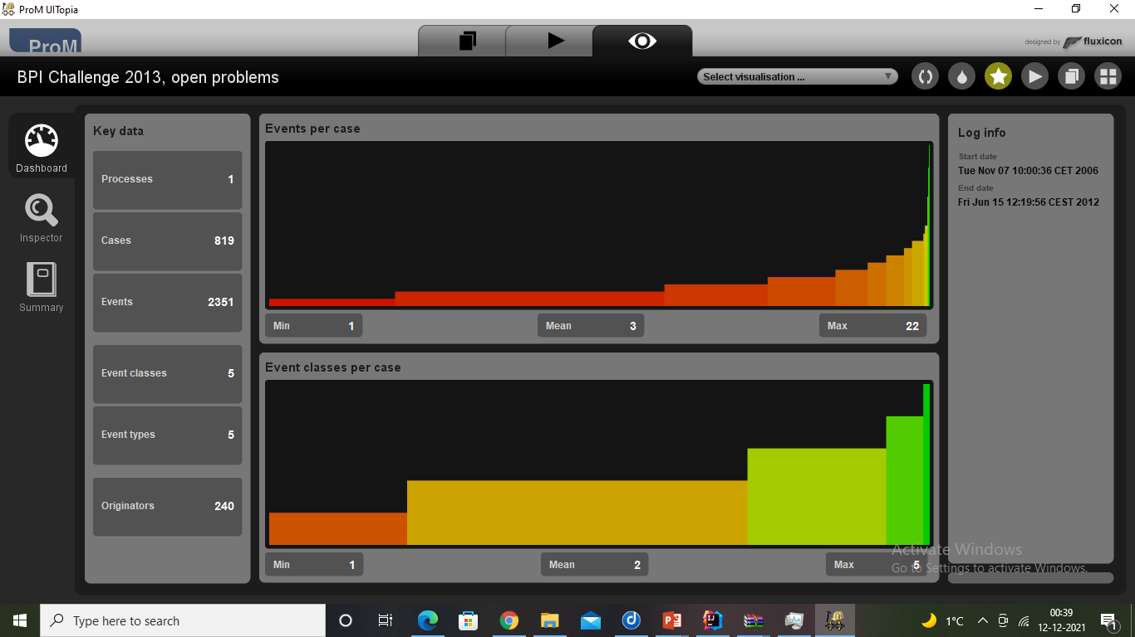
Overview of cases and events.

Slide 31
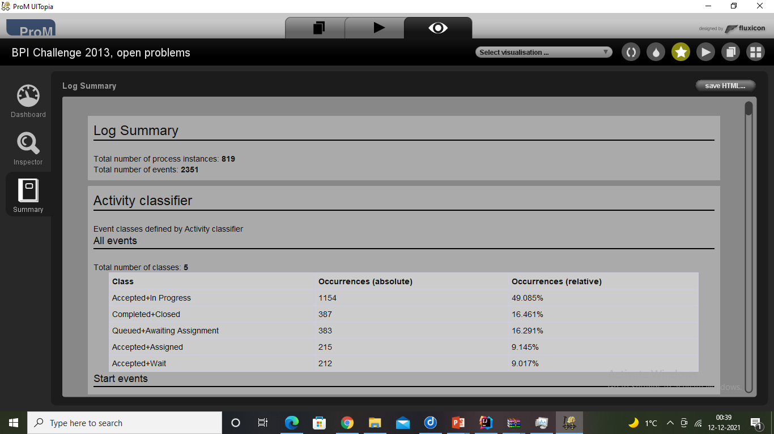
Summary about individual activity

Slide 32
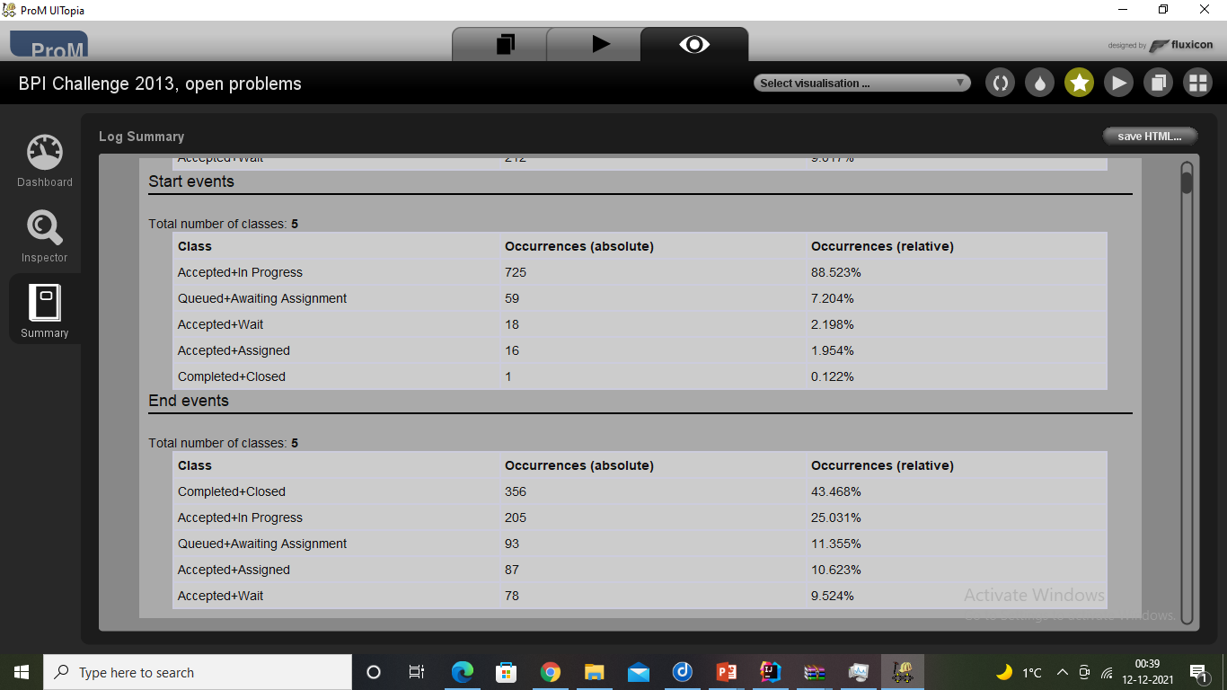
Start and End events

Slide 33
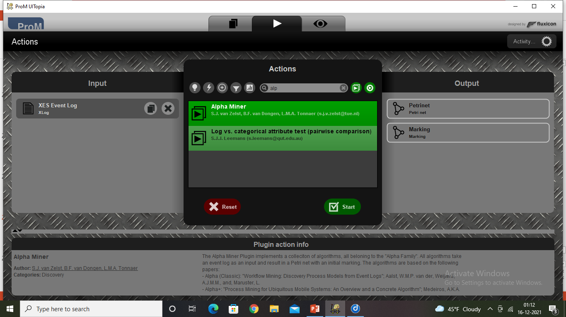
Applying Alpha miner algorithm

Slide 34
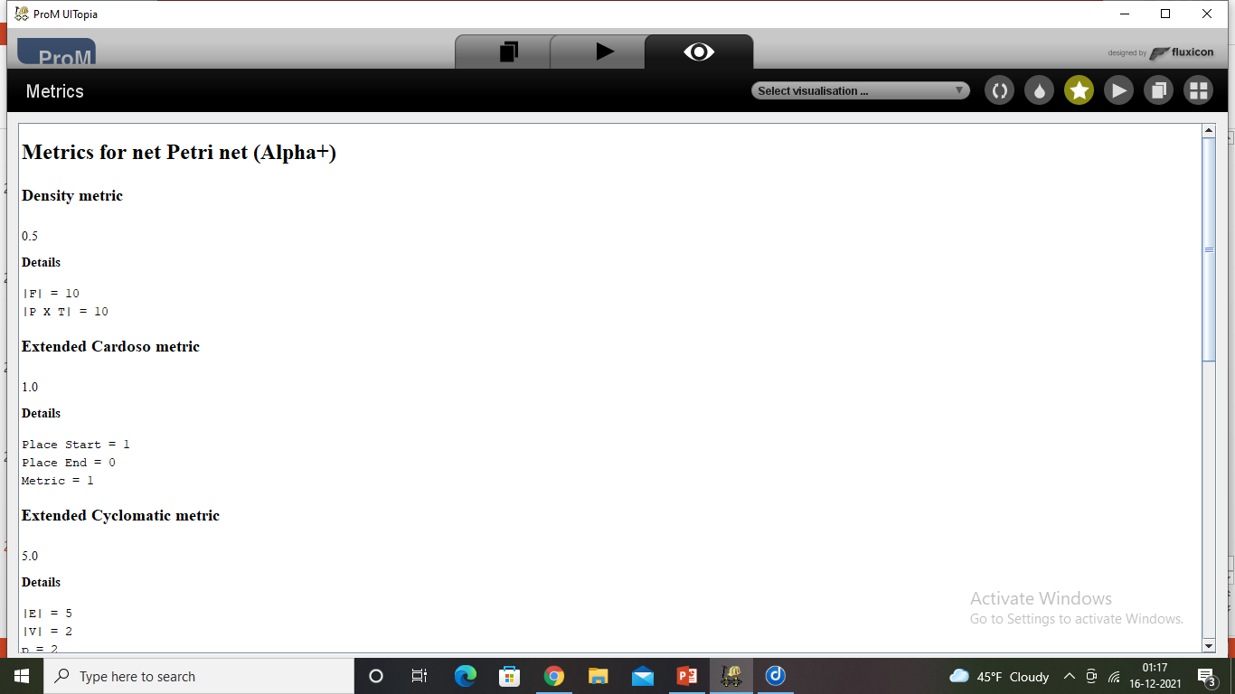

Using Alpha+, Alpha algorithms

Slide 35
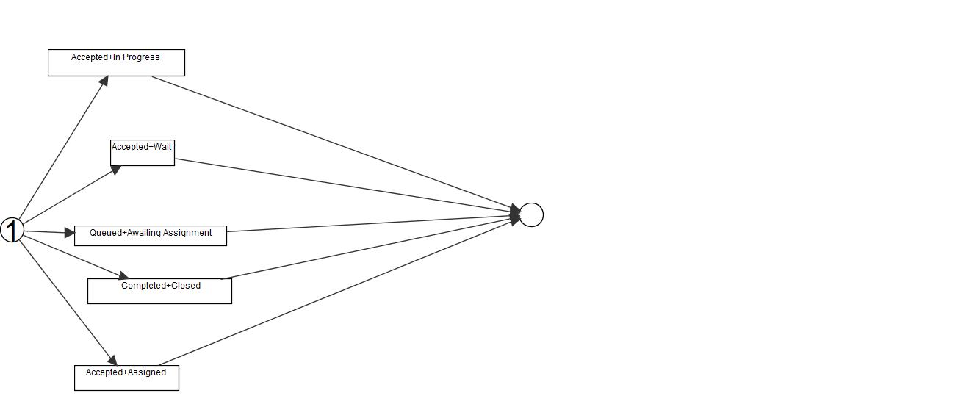
Petrinet using Alpha+ Miner

Slide 36
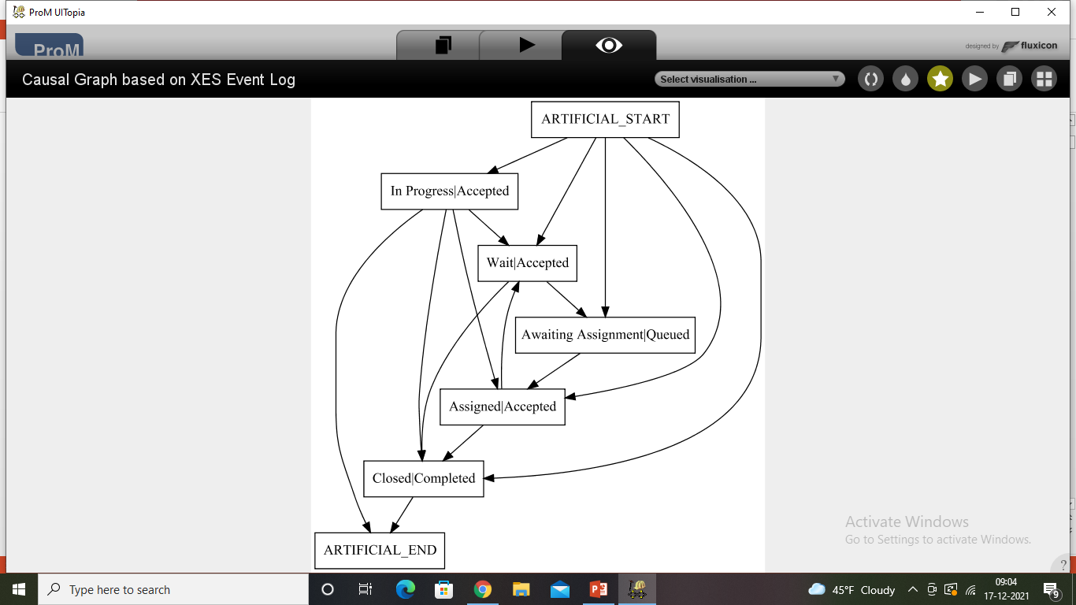
Heuristic Miner

Slide 37
Conclusion
So if we can address the mentioned issues in the log like:
organisational structure
division of work to organizations
high waiting time
proper distribution of work to different roles
Having too many variants of processing the issues etc.,
Then the organization can meet its goal easily.

Slide 38
Thank you!!

